Slide 1
AT-GAMES SOCIAL MEDIA GUIDELINES
TEAM CANADA / AUGUST 2023

Slide 2
BUILDING YOUR STORY
UNDERSTANDING AND NAVIGATING SOCIAL MEDIA
AS A TEAM CANADA ATHLETE

Slide 3
OBJECTIVE
TO EMPOWER ALL MEMBERS OF TEAM CANADA TO MAKE THE BEST POSSIBLE USE OF SOCIAL MEDIA AND TELL THE STORY OF THEIR SPORTS, THEIR TEAMS, THEIR JOURNEYS, AND THEMSELVES

Slide 4
AGENDA
TELL YOUR STORY
UNDERSTANDING THE CURRENT SOCIAL MEDIA ECOSYSTEM
BEST PRACTICES AND WATCHOUTS
TIPS AND TOOLS
HOW TEAM CANADA CAN HELP YOU
SOCIAL MEDIA AT GAMES

Slide 5
1. TELL YOUR STORY
FROM ATHLETE BRAND TO PERSONAL BRAND
HOMEWORK

Slide 6
EVOLVING FROM AN ATHLETE BRAND TO A PERSONAL BRAND
Athlete brand
Focus primarily on stats and performance
Superficial level of depth and purpose
Limited strategy
Not sustainable long-term
Personal brand
Provides deeper insight into your story and passions
Communicates transferable skills to business/life challenges
Strong personal brand connects with audiences who are not necessarily ‘fans’ of your sport

Slide 7
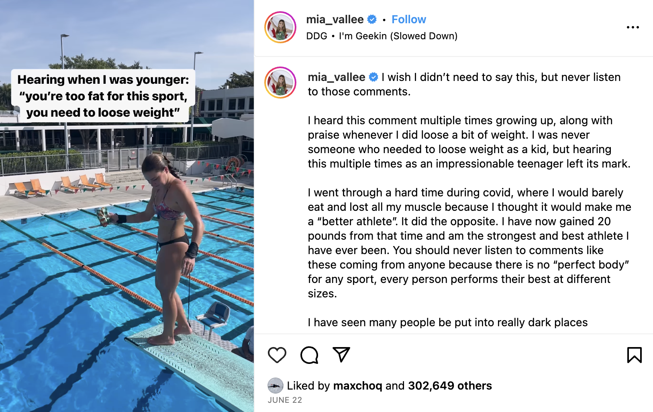
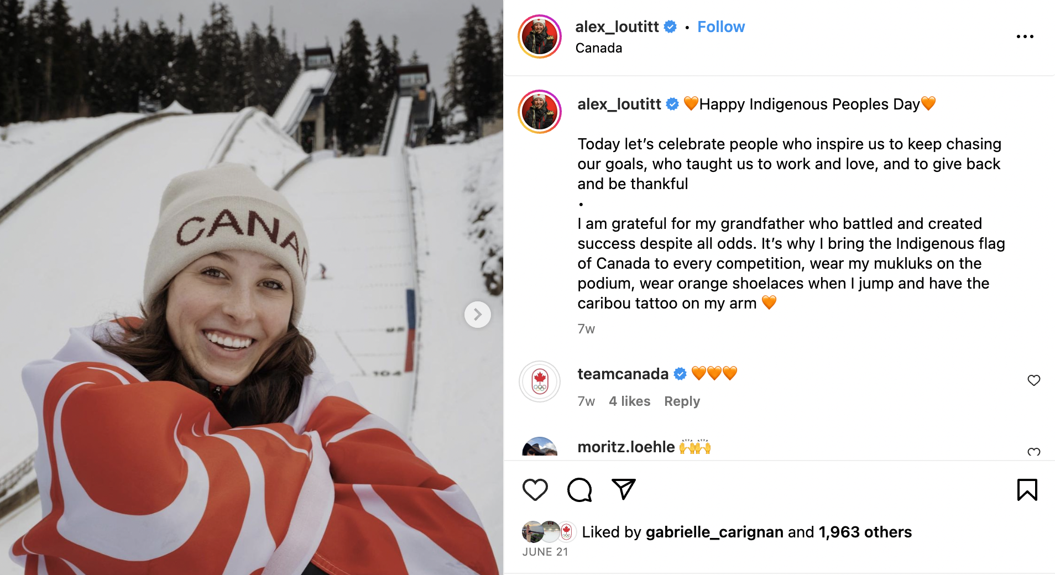
HOMEWORK: TELLING THE STORY OF YOU
The core questions that will help you define your personal brand:
What is my purpose?
What is my unique story/offering?
Who am I trying to engage with?
What opportunities am I trying to attract?
Is my brand sustainable long term and outside of sports

Slide 8
2. UNDERSTANDING THE CURRENT SOCIAL MEDIA ECOSYSTEM
TOP PLATFORMS BREAKDOWN
WHAT FANS, MEDIA AND MARKETING PARTNERS ARE CRAVING

Slide 9
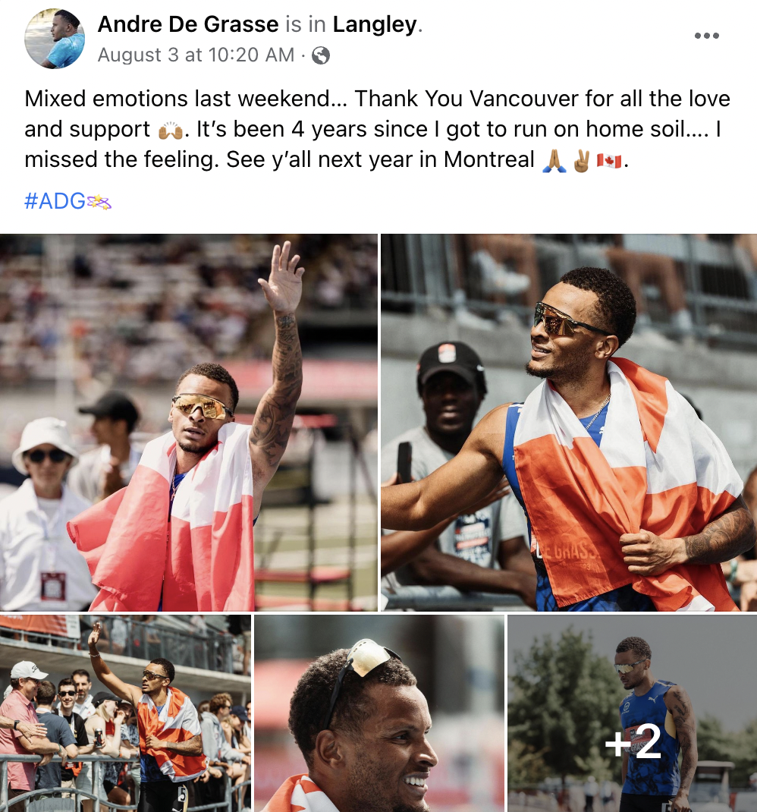
FACEBOOK
Summary
Channel with good reach and user base
Usage among teens and young adults have dropped in favor of Instagram, Tik Tok and Youtube
Best practices
Set a public page for yourself
Post more videos and lengthier blog-type posts
Engage with your community
Consider use of features like Stories and Reels
Think about adding someone you trust as a editor of your page
Accounts you should follow for inspiration: Mikaël Kingsbury, Marjorie Lajoie & Zachary Lagha, Max Parrot

Slide 10
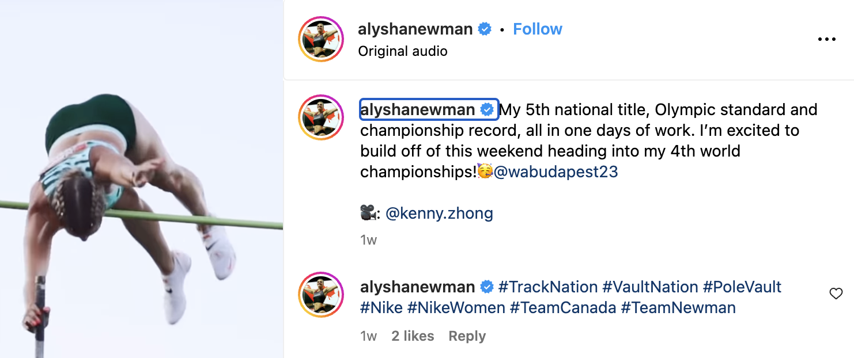
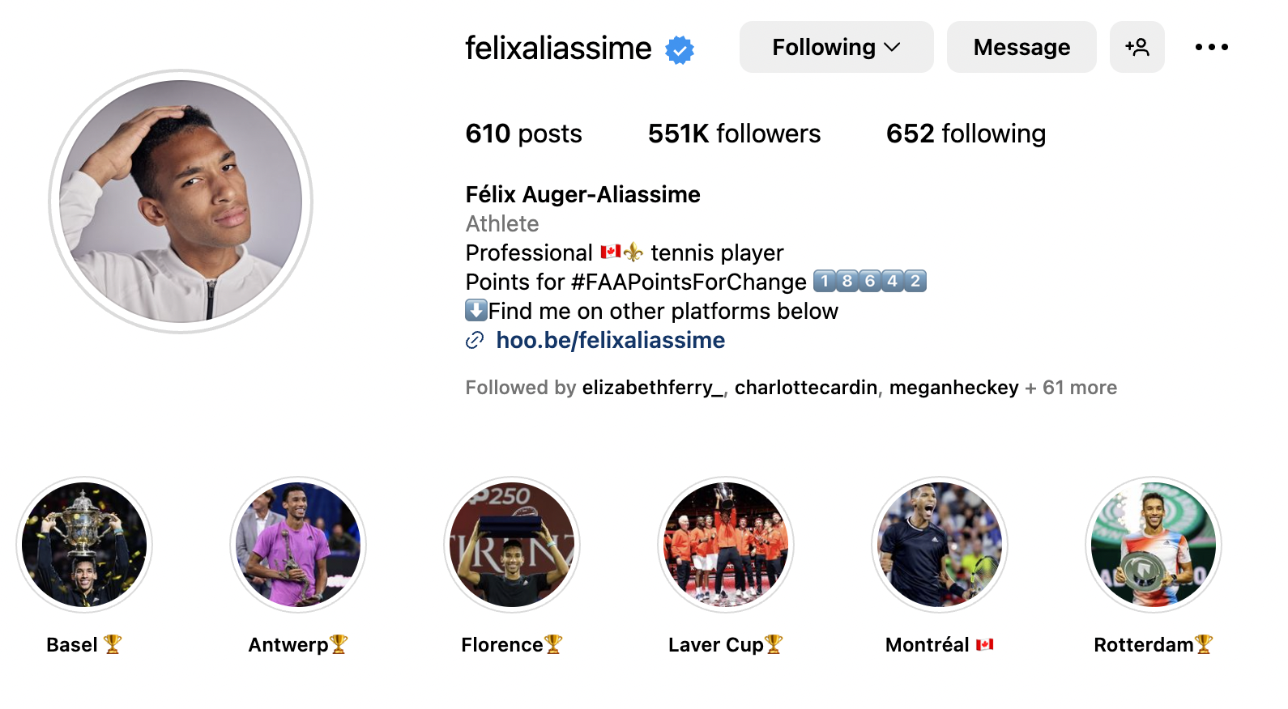
INSTAGRAM
Summary
Most established channel with greatest reach and user base
Photo & video-sharing social networking service owned by Facebook (videos = Reels)
Huge international popularity, making it great for brands/influencers
Was the fastest growing platform; now second behind TikTok
Best practices
Have a cohesive look & feel for a stronger brand
Maximize engagement with IG Stories, questions and quiz stickers, Reels.
Share and create Reels that can be shared on multiple platforms (FB, Tik Tok)
Use # hashtags in moderation (ex: #santiago2023)
Accounts you should follow for inspiration: Justine Dufour-Lapointe, Piper Gilles, Mark McMorris, Ivanie Blondin Mia Vallée

Slide 11
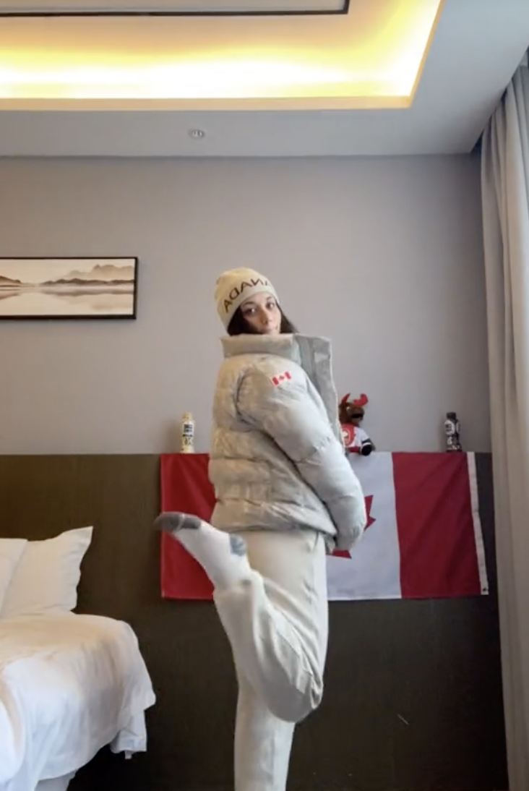
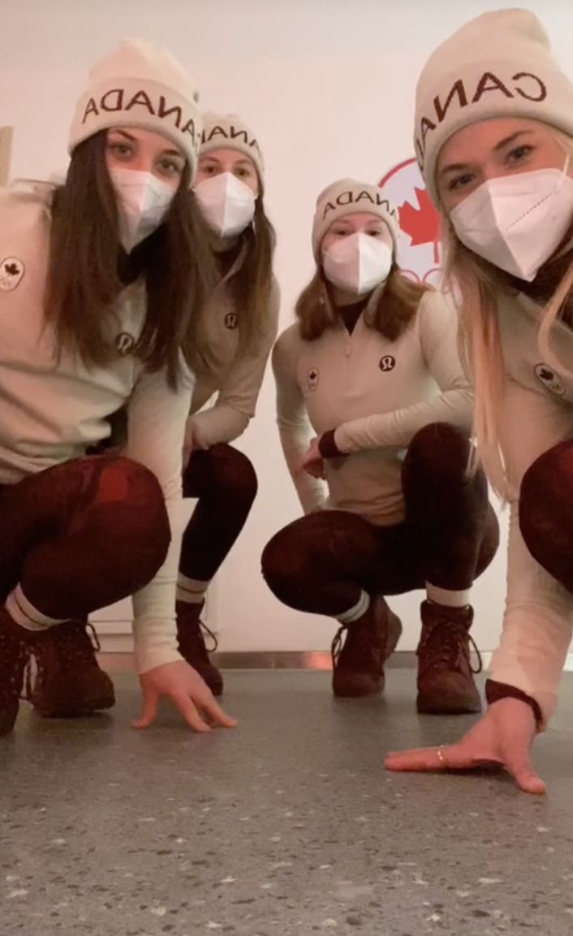
REELS
Summary
Best content format for greatest reach, user base and engagements.
Video-sharing social networking service owned by Facebook (available on Instagram and Facebook)
Huge international popularity, making it great for brands/influencers
Best practices
Create short engaging content (less than a minute preferred)
Catch their attention within the first 3 seconds
Create content based on humour, trends, educational or emotional
Use trending audio: sounds or music (if you have another sound, put the trending sound in the background at 0%)
Use # hashtags in moderation (ex: #santiago2023)
Good quality video but not too produced
Use relevant trends that work for your brand/personality
Use different words in the caption/video/title to increase SEO
K
Accounts you should follow for inspiration: Justine Dufour-Lapointe, Piper Gilles, Mark McMorris, Ivanie Blondin Mia Vallée
HOT TIP: Lululemon kit reveals work very well!

Slide 12
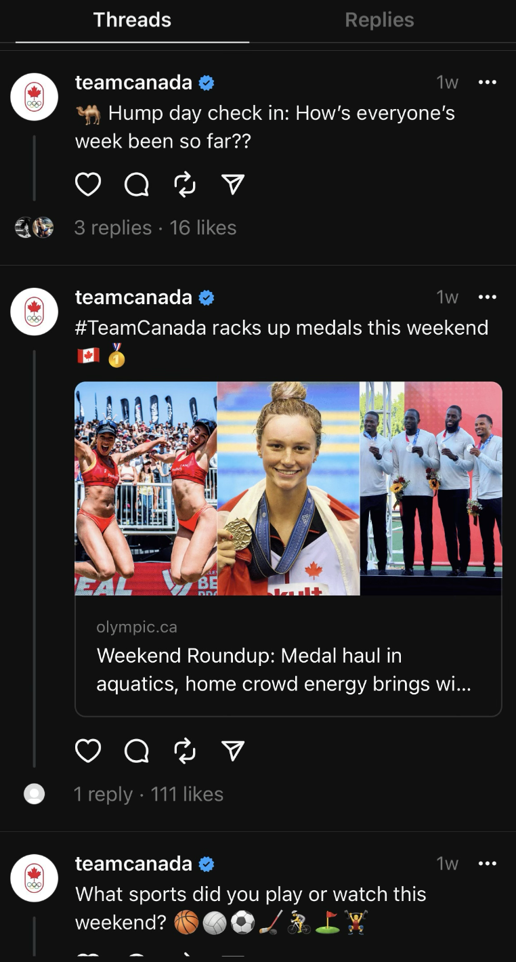
THREADS
Summary
NEW platform created by Meta (Facebook) similar to Twitter = Microblogging service on which users post and interact with Tweets, aka threads
Ideal format for timely content, making it a great source for news outlets
Best practices
Make those 280 characters count
Light hearted content
Bilingual athletes: Tweet the same content in both languages
Interact with fans by replying to their threads

Slide 13
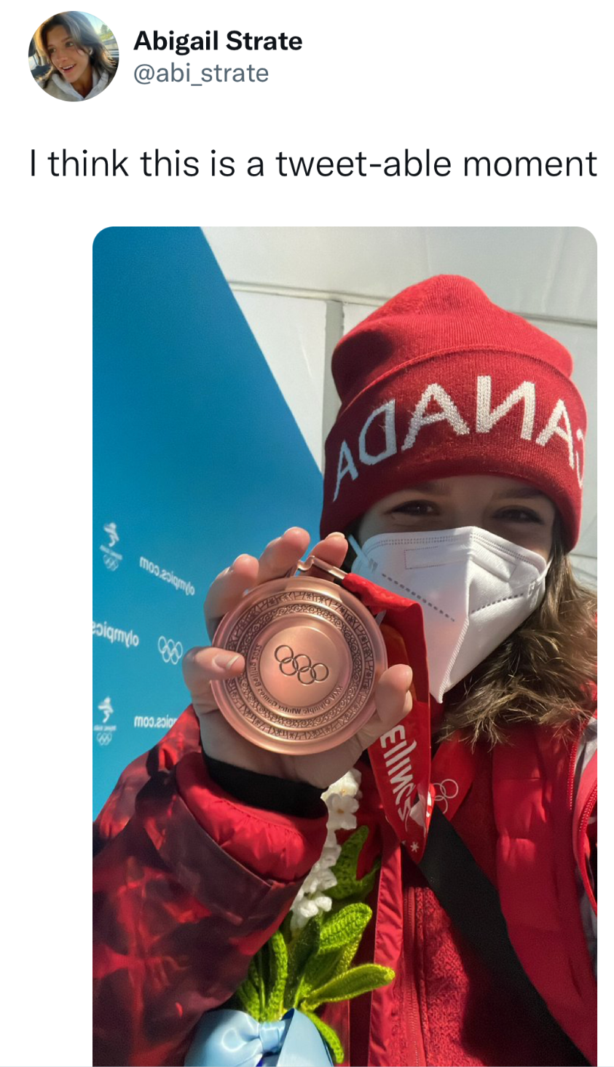
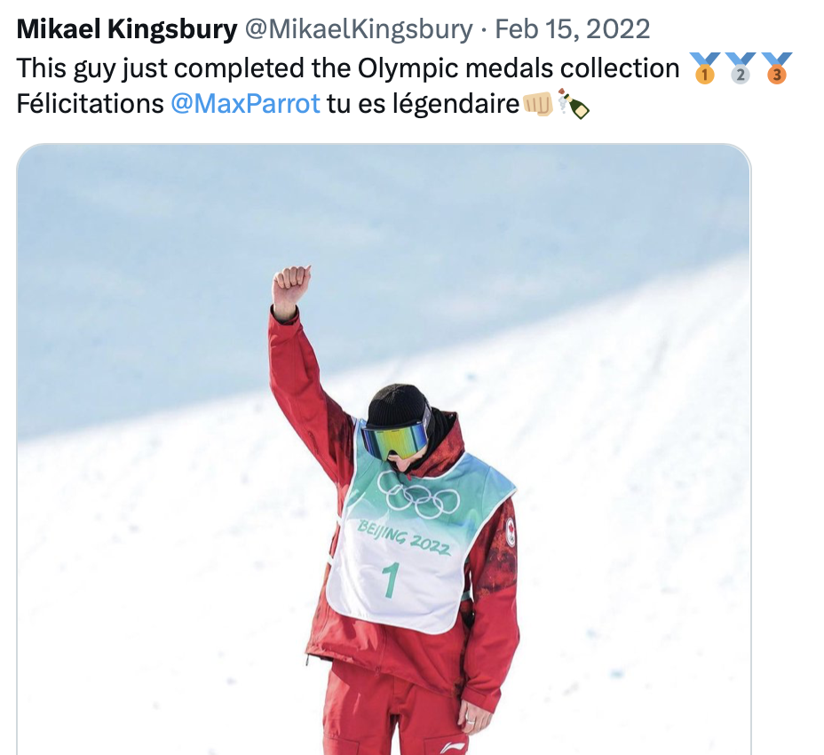
‘X’ aka TWITTER
Summary
Microblogging service on which users post and interact with Tweets
Ideal format for timely content, making it a great source for news outlets
Best practices
Make those 280 characters count
Maximize engagement with Polls, GIFs, video
Bilingual athletes: Tweet the same content in both languages
Interact with fans that mention you/tag you in photos
Use # hashtags in moderation (ex: #santiago2023)
Do not start with @athletename
Accounts you should follow for inspiration: Natalie Spooner, Mikaël Kingsbury, Shannon Szabados

Slide 14
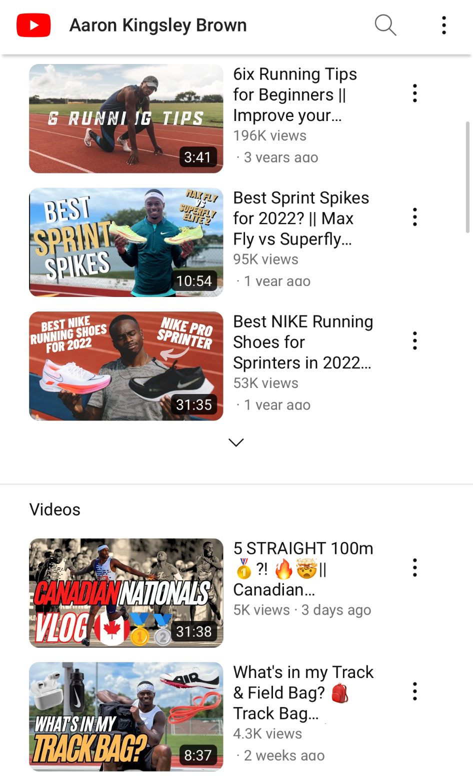
YOUTUBE
Summary
Online video sharing platform
Remains second-most used social platform by Canadians behind Facebook
Best practices
Vlog entries to connect with your fans
Aim for longer-form video with some editing
Training videos and B-Roll media can use
Leverage your YouTube channel as a tool to practice your narrative and be comfortable on camera
Accounts you should follow for inspiration: Aaron Brown, Melissa Humana-Paredes, Roman Sadovsky, Mark McMorris

Slide 15
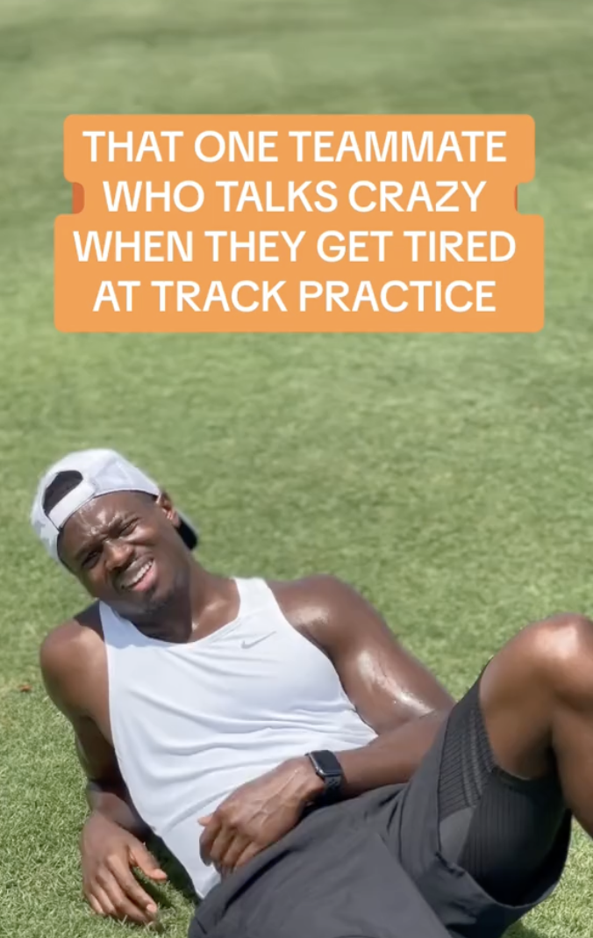
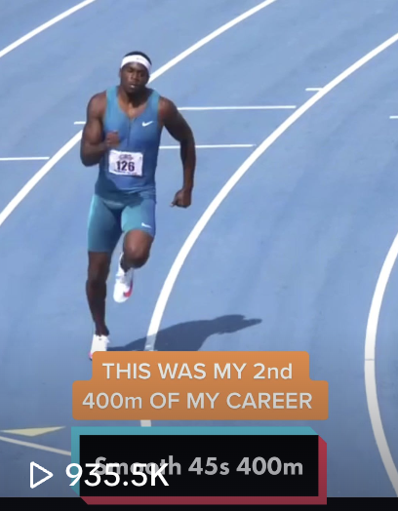
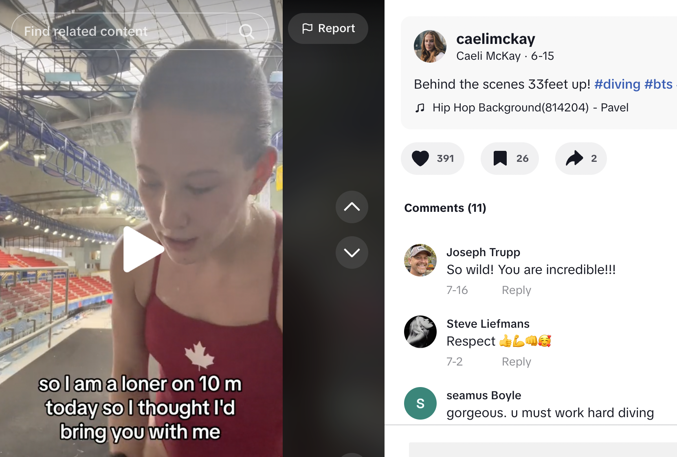
TIKTOK
Summary
Video-sharing social networking service
Used to create short dance, lip-sync,comedy or talent videos
Humour and trending content is at the center of the app
Most-downloaded app on the App Store in 2019 & 2020
Best practices
Show-off your athletic abilities and skills
Take people behind the scenes of your training
Let your creative/quirky/musical side show here
Participate in trends and viral challenges
Use effects and filters
Use # hashtags in moderation (ex: #fyp #yoursport)
Engage through comments with other brands/influencers/athletes for increased visibility
Reply to comments in video form
Accounts you should follow for inspiration: Piper Gilles, Mark McMorris, Sarah Nurse

Slide 16
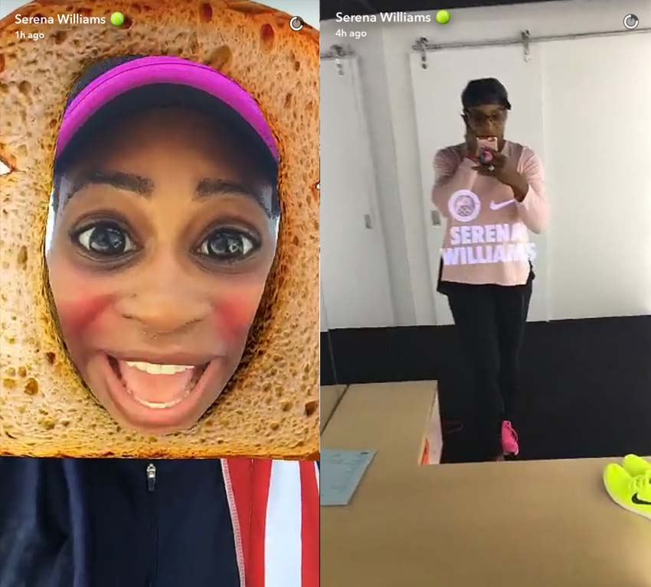
SNAPCHAT
Summary
Multimedia messaging app
Has seen a huge resurgence since late-2018
Users can create ephemeral low-fi content, or switch to ”Discover” for more professionally produced publisher content
Best practices
Create videos over images when possible
Use tools like Memories, masks & filters
Surprise your fans by replying to their Snap

Slide 17
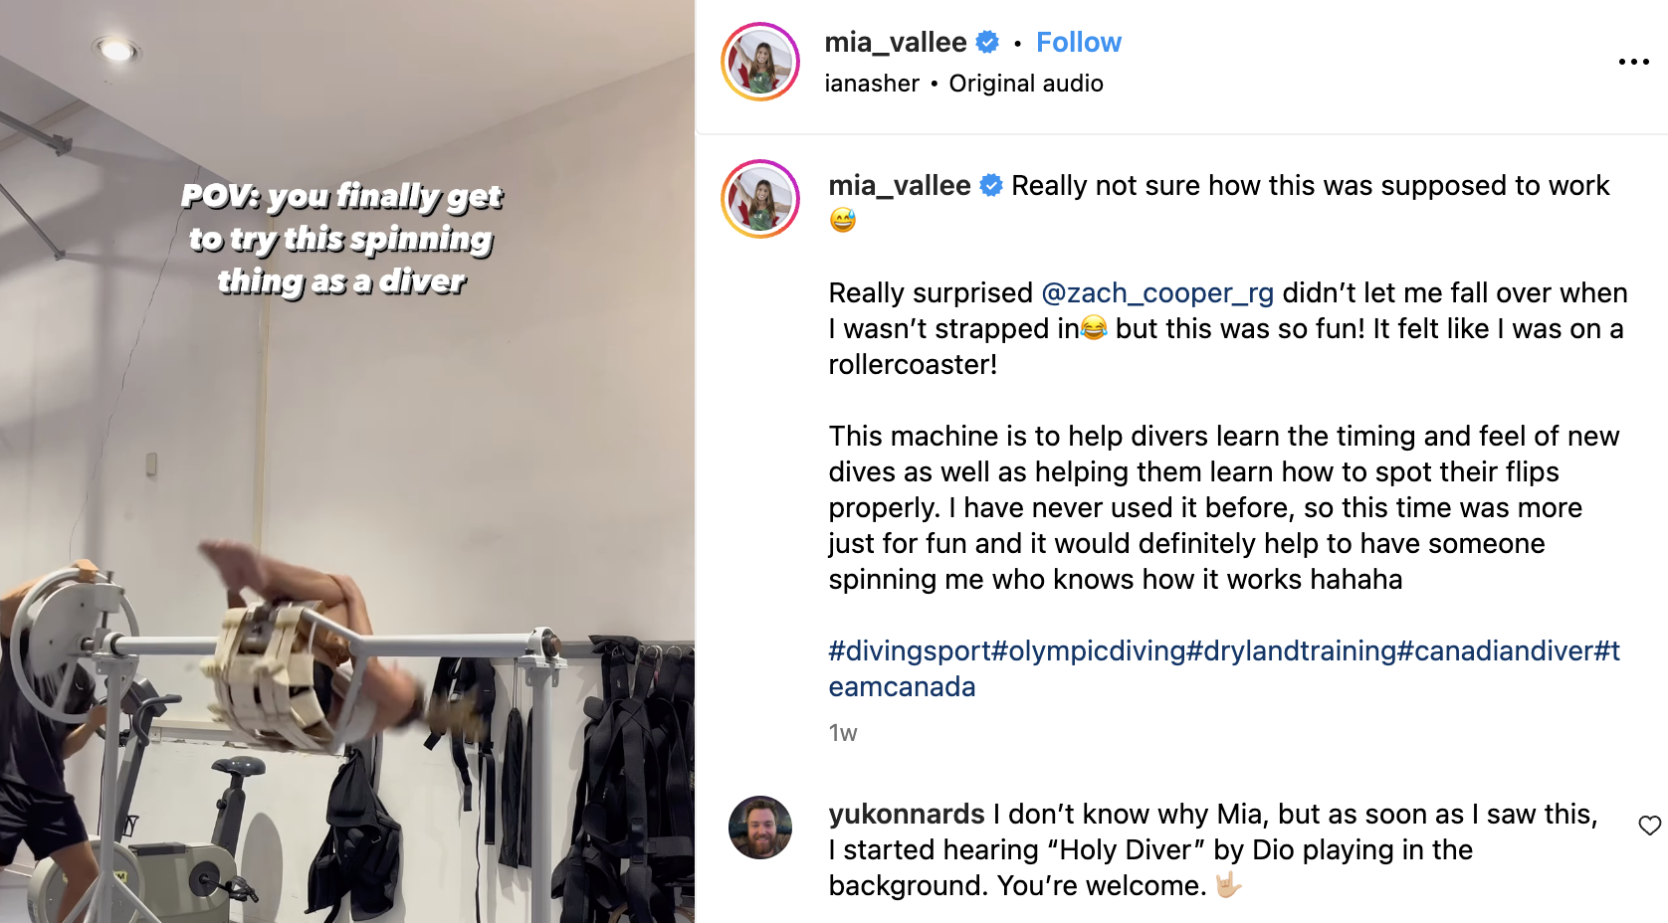
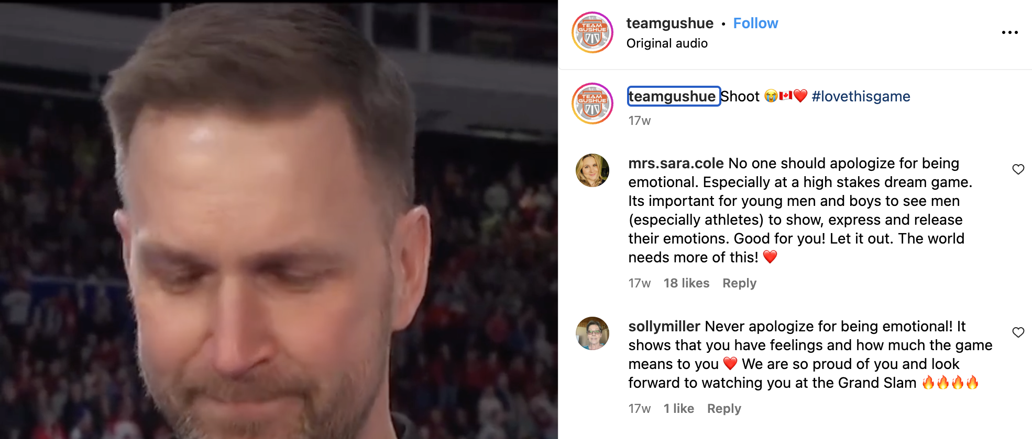
What fans, media & marketing partners
are craving
A sense of proximity: Behind the scenes, blog posts and vlogs
Impressive and inspiring content: Photoshoots, B-roll, competition footage and hardware
Curated taste and added value: Choose brands you want to partner with and show them some love
Feature what make you unique: hobbies, talent, schools, new and innovative training, tips

Slide 18
3. BEST PRACTICES AND WATCHOUTS
YOUR GAME PLAN
YOUR AT-GAMES PLAN
WATCHOUTS

Slide 19
YOUR GAME PLAN
1. Have a plan to tell your story
2. Choose which platforms to use — it’s okay to not be on every platform
3. Maintain the username — keep your username consistent across all platforms if possible
4. Establish your social media voice and tone (post in first-person, diary-type format)
5. Keep your voice consistent
6. Learn everything you can about your audience
7. Pay attention to your peers (competitors, NSO, international federation, @teamcanada, @santiago2023 or @panamsports) and engage with them (follow, like, comments, sharing and resharing)
8. Monitor your mentions
9. Stay interested in your industry
10. Know your platform basics

Slide 20
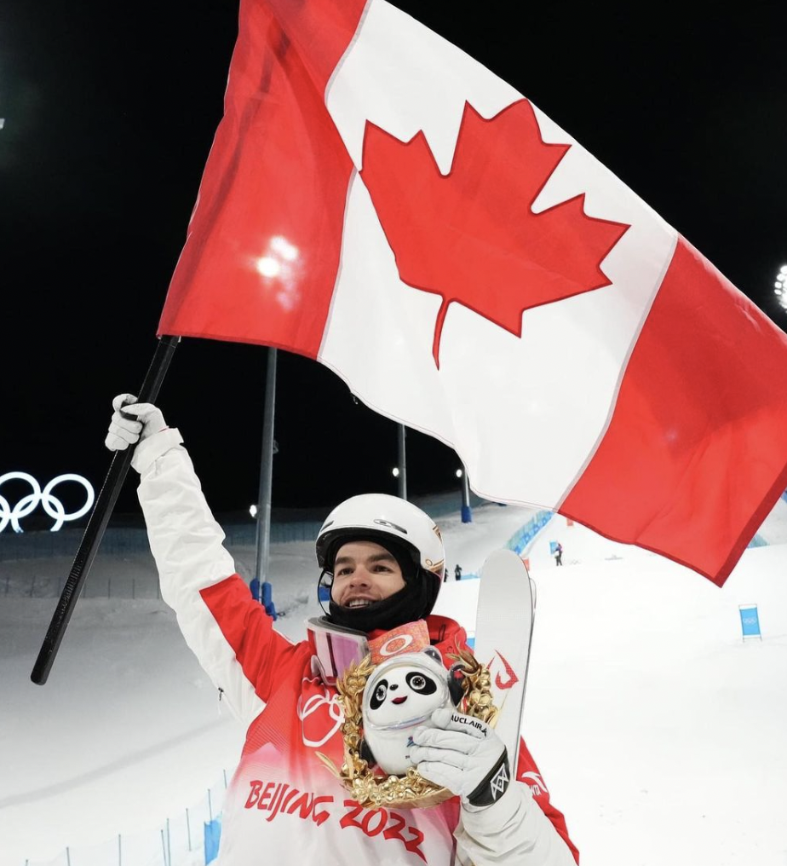
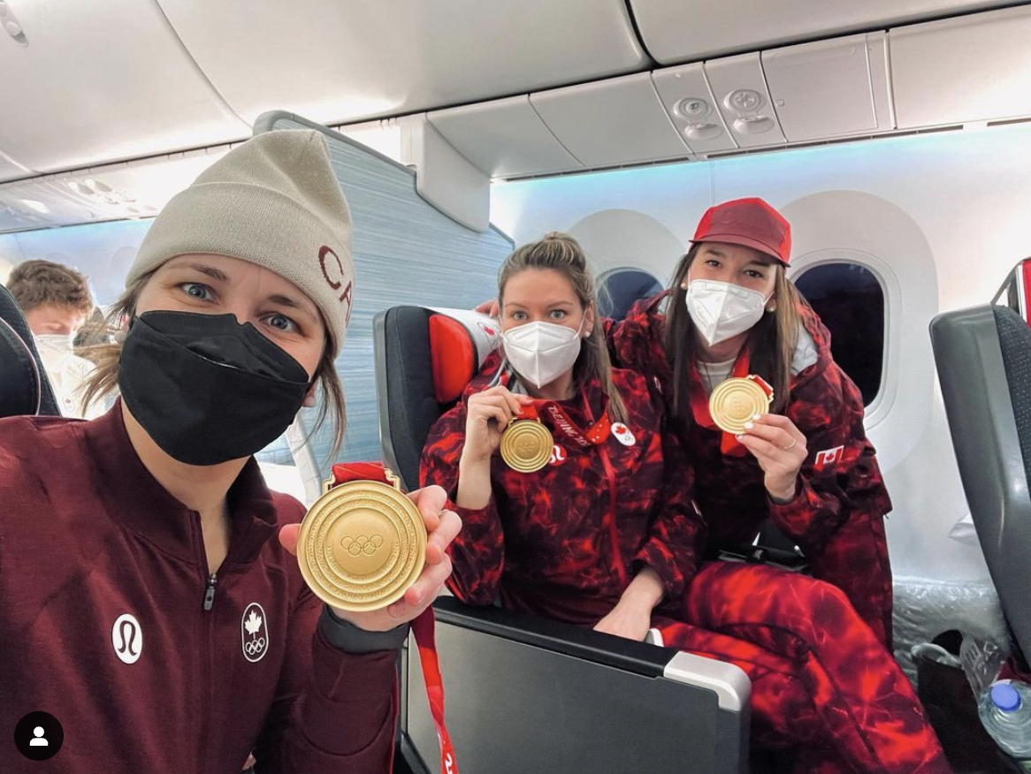
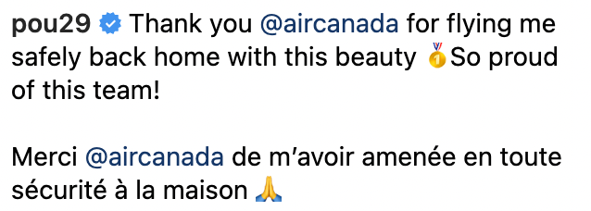
YOUR AT GAMES PLAN
1. Have a plan
2. Hand off account management during competition windows to someone you trust
Keep your fans informed if you are going dark
3. Consider scheduling posts, rely on someone you trust to post for your or distance yourself from social media entirely
4. Consider posting post-competition and give an update to your fans: offer a glimpse into your thoughts. As hard as it might be, that’s what fans want to see.
Ultimately, fans are following your journey through all the up and downs.

Slide 21
WATCH OUTS
The Internet is forever
What may seem like a harmless photo could haunt you later on
Direct messages aren’t private
Can be screenshotted and shared publicly
Try to not repost the same content across channels, change it up
Don’t over-post on channels
Quality over quantity
Credit creators and photographers
Don’t use of profanity or derogatory language, think of your young fans
Choose music carefully, be respectful
Raise your voice with passion, while avoiding being controversial
Avoid criticizing sponsors
The Internet is forever

Slide 22
4. TIPS AND TOOLS
NOTIFICATION MANAGEMENT
GETTING VERIFIED
APPS

Slide 23
NOTIFICATION MANAGEMENT
Instagram
Range of notification settings for posts, stories & comments
Likes
Likes & comments under your posts
Photo tagging: who can tag you in a photo?
Only people you follow or everyone
Comments
Comment Likes & Pins
You can pause all notifications
Following & Followers
Accepted Follow Requests
Friends on Instagram
Mentions in bio
Messages
Message Requests
Group Requests (turning this off will stop people you don’t follow from putting you in Group DMs)

Slide 24
NOTIFICATION MANAGEMENT
Twitter
Has a range of settings
Can mute certain notifications
Can get push notifications, SMS or email notifications
Can decide to not allow people to tag you in photos
Facebook
Use a fan page and not your personal account
Snap
Public account
Who can contact you
Who can see your story
Tik Tok
Has a range of settings
Can mute certain notifications
Can get push notifications, SMS or email notifications

Slide 25
NOTIFICATION MANAGEMENT
Determine an approach to notifications
What notifications are most valuable to you?
How will you deal with negative comments?
Make time to review notifications

Slide 26
VERIFICATION
HOT TIP: Make sure to fill out the 5 links with mainstream media sources like CBC, TSN or local newspapers if possible
Team Canada can no longer facilitate the verification of athletes and NSOs, but we can help guide you through the verification process.
Click this link and follow the steps requesting a verified badge: https://business.facebook.com/help/media/topics/account/verification/request_verified_badge
Authentic: The account must represent a real person or NSO. Ensure the usernames you currently have are the ones you wish to keep once the verification happens.
Unique: The account must be the only public presence of this person or NSO.
Complete: The account’s description must be completed, with a profile photo, with a verified email address. The account must have had recent activity, including logging in and posting at least once in the six months prior to the Team Announcement.
Notable: The account must represent a well-known, highly searched person or NSO. Platform partners verify account that are featured in multiple news sources.
Verification is not guaranteed and that it is at the discretion of Facebook, Instagram to approve the verification of each of the athlete’s social media accounts.

Slide 27
APPS
Apps to help you organize and plan your social media content:
Notes app – write out ideas you have here
Google Suite (docs, sheets) - brainstorm ideas with your team simultaneously and establish a posting calendar
Later (there’s a small fee)
Apps to help you elevate your content :
Photo editing: PS Express, VSCO, Touch Retouch, Snapseed, Lightroom
Videos: Life Lapse (stop motion videos), Adobe Premiere Rush, Cap Cut, Reels or Tik Tok directly in-app
IG Stories: Unfold, Canva
Instagram Feed: Preview

Slide 28
5. HOW TEAM CANADA
CAN HELP YOU
SOCIAL MEDIA BEST PRACTICES, Q&AS AND COACHING
TEAM CANADA & SOCIAL PLATFORM PARTNERS
CREATING CONTENT TOGETHER
OPPORTUNITIES WITH TEAM CANADA PARTNERS

Slide 29
HOW TEAM CANADA CAN HELP
Social best practices & coaching
Links to decks & resources
Tailored webinars for your team’s social media needs (paused during Games window)
Team Canada & social platform partners
Athlete Verification & troubleshooting (impersonation or hacked accounts)
Creating content together
Amplify your content on our official channels
Feature you in our natively posted UGC (ex. IG Takeovers & blog posts)
Opportunities with Team Canada Partners
Team Canada will seek opportunities with our marketing partners to produce exciting and compelling content around your journey. Discuss interesting narratives with your comms manager.

Slide 30
6. SOCIAL MEDIA AT GAMES
WHAT YOU CAN AND CANNOT SHARE ON SOCIAL MEDIA
CONSEQUENCES
TIPS

Slide 31
WHAT CAN I SHARE ON SOCIAL MEDIA?
What can I capture?
Athletes and NSOs can take photographs and record audio/video content of the Pan American Games using non-professional equipment.
You are allowed to capture as much content as you want for your personal archives, but...
What can I share on social media?
Athletes and NSOs can share static content of the Pan American Games (Field of play or Back of the house) on their personal social channels.
Athletes and NSOs can share video content from Santiago and Chile, including areas that qualify as Field of Play, but exclude Back of the house.
Can I...
Share videos of the field of play on social media? - for PanAms, Yes. Not for Olympic Games. You can amplify videos from an Official Right Holders. In Canada - CBC/Radio-Canada.
Share behind the scenes videos of the Athletes Village or competition venues? - No, ‘Back of the house’ is off limits for video sharing on social media.
Do an IG Takeover for my NSO or Partner? - No, that does not qualify as personal social channels, but we will be taking lots of similar content for you to share on your channels

Slide 32
CONSEQUENCES
In case of non-respect of these Guidelines, the terms of their accreditation and any applicable laws or regulations, the athlete will be required to remove the Games Content from their account or site immediately upon request. Depending on the circumstances, further measures or actions may be taken by the Canadian Olympic Committee or Panam Sports.

Slide 33
TIPS
Be safe and respectful
Tag @teamcanada on all your Games content, including IG Story, we will amplify you on our channels
#teamcanada or #équipecanada on all your Games content, including IG Story, so that your content shows up on the hashtag library or explore page
# or @santiago2023 if you want extra amplification
If video content captured off limits finds its way onto social media, ensure there is no mention of the off limits areas.

Slide 34
THANK YOU

