Slide 1
Media training 101

Slide 2
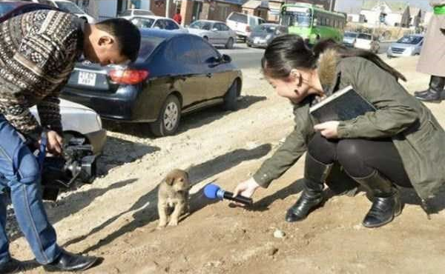
Why do an interview
Communicate with an audience
Influence that audience
Receive coverage
Build your brand
Build WCL brand
.

Slide 3

Do your homework
(I’m here to help)
What we can do in advance:
1) Know who you are speaking to
Find out:
The journalist’s name/publication
Focus of the interview
Questions or types of questions (not all journalists will give you these but some will send them in advance)
Type of story/angle
Others in the piece (if applicable)
Type of publication (video, audio, written, web, TV, radio, podcast etc.)
Is the interview live or recorded?

Slide 4

Do your homework
(I’m here to help)
What we can do in advance:
2) Being prepared
Have answers ready for obvious questions
Practice those questions and answers with teammates, family or in front of a mirror
Be prepared for hostile questions
Develop key messages (these are your fallbacks. If there is a question you do not want to answer, it is better to control the interview with a key message and bring it back on course)

Slide 5
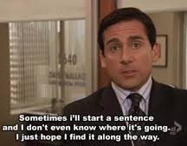
Key Messages
It is always good to have two or three key messages planed
These can be the things you want to come across in an interview
Less is more, keep these short and sweet so they can stand on their own.
Use examples (where available)
Examples of Key Messages:
  Feelings about competing at event/representing country
  Personal or team success
  How you overcame a challenge
  Motivations or inspirations
  Goals

Slide 6

Key Messages
Example of a personal key message:
  “I am working towards Olympic qualification”
  We can bring it back to this key message whether it is a positive or negative question. You won a tournament: “This is a stepping stone towards my goal of qualifying for the Olympics.” You lose in the first round: “While today is a disappointment, it won’t deter me from my goal of qualifying for the Olympics, I will get back in the gym and fix my mistakes.”

Slide 7
Controlling the interview
Key messages help to control the interview but there are other ways to do it.
Bridge- answer questions directly, but bring them back to the things you want to talk about.
Don’t speculate, a journalist may ask you something you don’t have an answer to, address why you can’t answer, then bridge back to you.
If you do not want to answer a question, you don’t have to but don’t just say ‘no comment’ then people assume the worst. Say why you are not in position to comment, then bring it back to your comfort area.
A way to deflect an unfair question: “What I can say is…”
Be honest, but don’t volunteer unnecessary information.
Never say “This is off the record” and then comment, a journalist can still use that. Some use different techniques than others. Remember despite your relationship, they have a job to do.

Slide 8
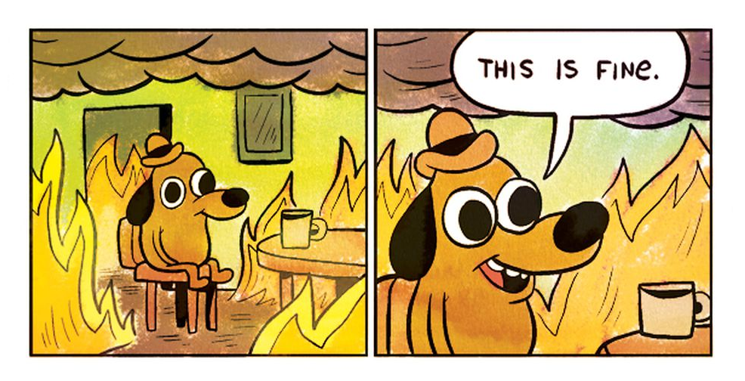
Hostile or negative questions
Depending where you are or where the journalist is from, you may get hostile or unfair questions. Journalist do this to create a headline.
The important thing is to remain calm and not let it throw you off.
Having those stock key messages ready will allow you to pivot.
Do not focus on the negative.

Slide 9
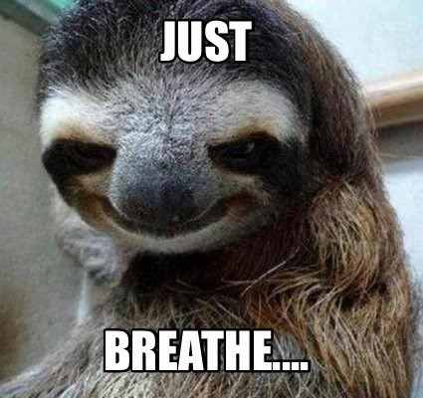
Tips and tricks
Handling nerves:
Remember that you are the expert on what is being asked.
Don’t rush, take time to breathe. A long pause seems much longer in your head than it actually is.
Be relaxed and yourself but try to stay serious. Be careful with jokes, as they can be misinterpreted.
Remember doing an interview after a loss is difficult, but if you give the journalists time during your lows, they will be there for your highs.
Mix Zones
Please walkthrough them, but you
don’t need to stop and answer!

Slide 10
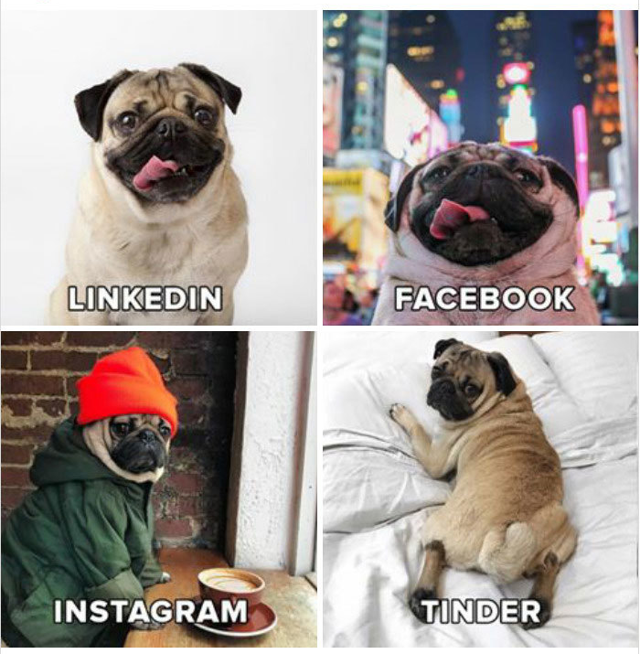
Social media
Use Social Media to build your brand, tell your story and share your journey
Establish a purpose, uniqueness, voice, target audience and plan for sustainability.
Determine what platforms you want to use and for what type of content, you don’t need to be on everything.
Social media is a great way to attract opportunities, show case things you think will appeal to your fans and potential partners.

Slide 11
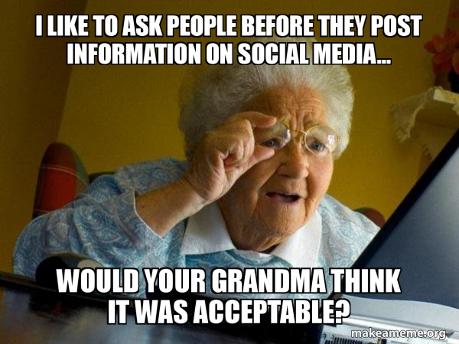
Social media
Things on social can be used by journalists
Ask yourself before you post – if you would be ok with something you post being in a news story
DMs are not private (can be screenshot)
If you wouldn’t say it to a close friend or coach, parent, grand parent, you probably don’t want to say it to a journalist, or post it.
Always re-read and reflect on something before hitting post, do you want this attributed to you in five years? The internet is forever!
Be mindful of your content. Be respectful, don’t use expletives, dishonest or defamatory statements or share sensitive information.

Slide 12
Ukraine Russia
At the World Championships/Multi Sport Games you may be asked to comment on the inclusion of Russian and Belarussian athletes.
WCL supports and adopts the position of the COC (next slide).
This is up to you if you want to answer. If you do, we encourage you to defer to the COC/WCL position, if it aligns with your views.
Use the bridge technique if you want to return to something else you want to talk about.

Slide 13
Ukraine Russia
Canadian Olympic Committee and Canadian Olympic Committee Athletes' Commission position:
"In these exceptional circumstances and while the invasion is ongoing, the Canadian Olympic Committee (COC) supports the exclusion of Russian and Belarusian athletes from international sport. The position was made clear by the COC and COC's Athletes' Commission during separate consultations with the IOC in the days ahead of the IOC Executive Board meeting. We reaffirm our support for the people and athletes of Ukraine."
Canadian Olympic Committee position on pathways for neutral athletes:
"If there is some way of having exemptions for athletes who can prove that they are neutral and opposed to the war, we would be willing to consider what the international community might be able to do. But we remain very skeptical that a solution will be found.“
Canadian Olympic Committee position on sanctions imposed on multiple Canadian Olympians:
"The Canadian Olympic Committee condemns the sanctions imposed by the
Russian Government on Canadian Olympians. They are completely
unjustified and go against the value of free expression.“

Slide 14
Ukraine Russia
Potential Questions you may be asked:
Q: Do you believe Russian and Belarusian athletes should be allowed to participate in international competition?
Q: Do you believe Russian and Belarusian athletes should be able to
compete as neutral athletes in international competition?
Q: Will you do anything if you are matched up with a Russian or Belarussian athlete?
Bridging examples:
It is not my decision, nor that of my NSO or of the Canadian Olympic Committee's to make. It is up to my international federation. However, I stand in line with my NSO and the COC in support of the people and athletes of Ukraine.
Actually, I believe that question is better suited for the COC or WCL, or those with
expertise in this. My focus is to represent Canada and do my best at the
World Championships.

Slide 15
QUESTIONS

